Slide 1

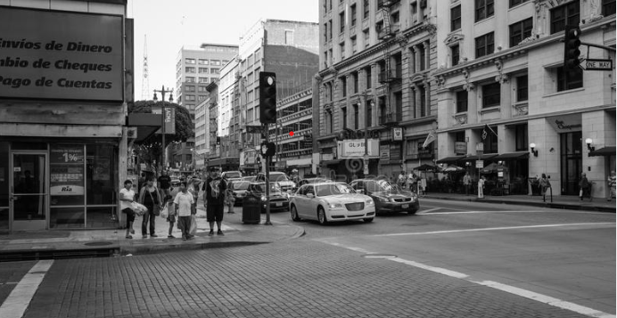
Los Angeles Crime Weapon prediction using Machine learning models
Naga Chandrika Bhamidi
DATA 606- Capstone Project
Dr. Chaojie Wang, Nov 22nd, 2022

Slide 2


Under the guidance of Professor Chaojie WANG

Slide 3

Contents
Abstract
About Data set
Pre-Processing
EDA
Machine Learning models
Conclusion

Slide 4

Abstract
Crime is one the most common social problems in the country impacting public welfare, children development, and adult socio-economic status. Crime analysis and prevention is a systematic approach for identifying and analyzing trends. With the advent of modern technology, crime data analysts can help Law Enforcement agencies to prevent crime incidents. I would like to represent an extensive proposal about the varying crimes in the city of Los Angeles. The purpose of this data analysis is to be aware of the patterns in criminal manners in order to anticipate crime activity and how can it be prevented. Predict the analytics for investigating various crime trends and patterns. The main objective of this project is to provide location based, and crime-type based rate and count, which may help the society to minimize the crime.

Slide 5
Introduction
Los Angeles is located in southern California and is the second most populous city in the United States (second only to New York), as well as the heart of the film and television industries. According to the International Association of Crime Analysts (IACA), crime analysis is defined as a profession and process in which a set of quantitative and qualitative techniques are used to analyze data valuable to police agencies and their communities. It includes the analysis of crime and criminals, crime victims, disorder, quality of life issues, traffic issues, and internal police operations, and its results support criminal investigation and prosecution, patrol activities, crime prevention and reduction strategies, problem solving, and the evaluation of police efforts.

Slide 6
Framework
Analyzing the dataset
Data Processing
Creating new Csv file
EDA
Train and Test Data
Logistic Regression
Random Forest
Knn,
Decision Tree.

Slide 7

About the data set
This data set contains the "Los Angeles crime data history." A crime is an unlawful conduct, and we have heard about many sorts of crimes that have occurred in various locations. In this section, I will classify the Los Angeles crime report, which covers all sorts of crimes that are typed on paper, and therefore there may be some inaccuracies within the data. We have data from the year 2020 until the present. The data set contains 5,64,163 rows and 28 columns. In this 28 columns
DataSet-Link: https://data.lacity.org/Public-Safety/Crime-Data-from-2020-to-Present/2nrs-mtv8

Slide 8
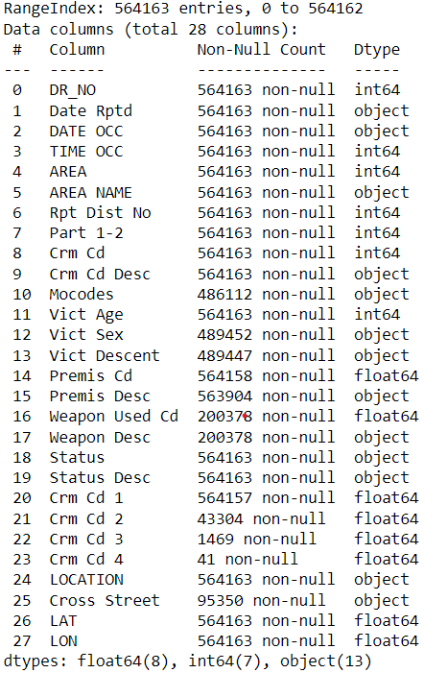
AREA NAME • Rpt Dist No- sub-area • Crm Cd - crime committed • Crm Cd Desc - Crime Code • Vict Age - Indicates age of victim • Vict Sex • Premis Cd - location • Premis Desc - Premise Code • Weapon Used Cd - type of weapon • Weapon Desc - Weapon Code • LOCATION • LAT - Latitude Coordinate • LON - Longitude Coordinate • VictIM Descent
Out[4]:
(564163, 28)
Out[4]:
(564163, 28)
ATTRIBUTES

Slide 9
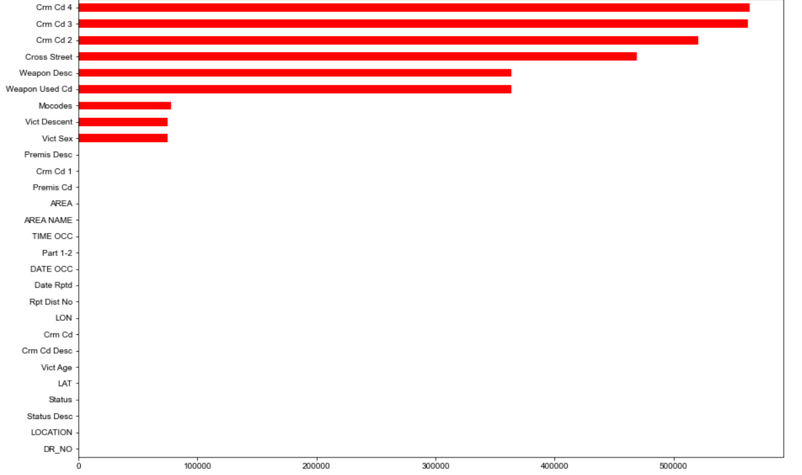
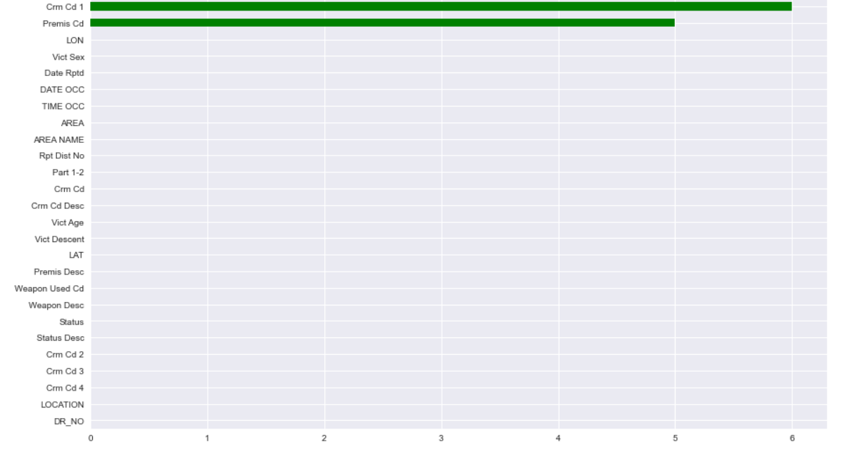
DATA CLEANSING NULL Values in dataset

Slide 10

EXPLORATORY DATA ANALYSIS

Slide 11
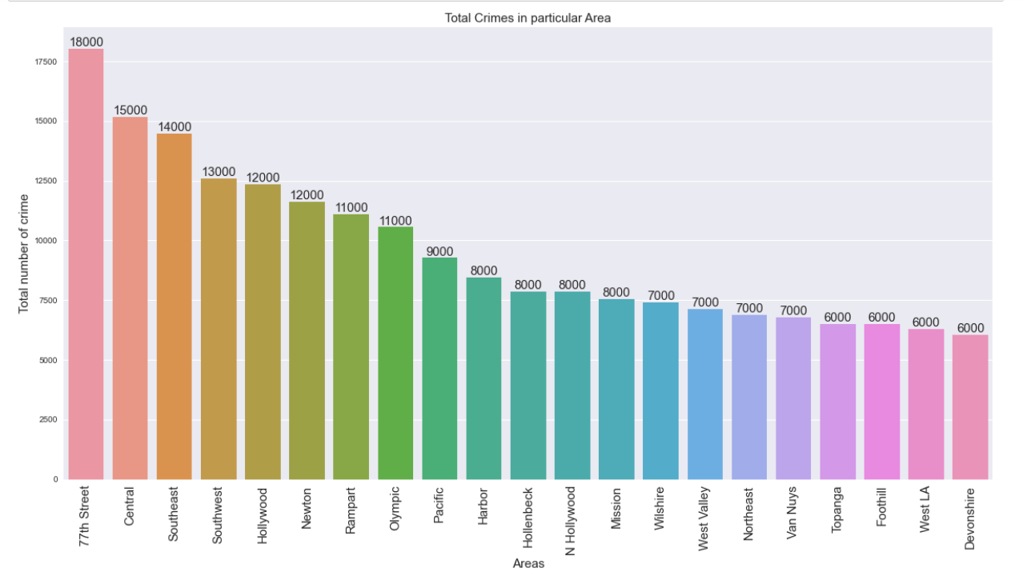
Crimes according to AREA

Slide 12
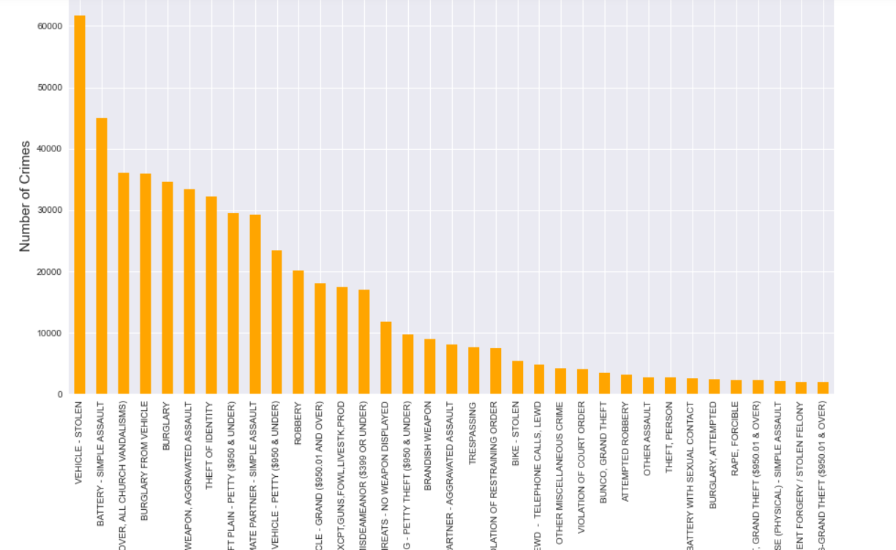
Top 35 Crimes in Los-Angeles

Slide 13
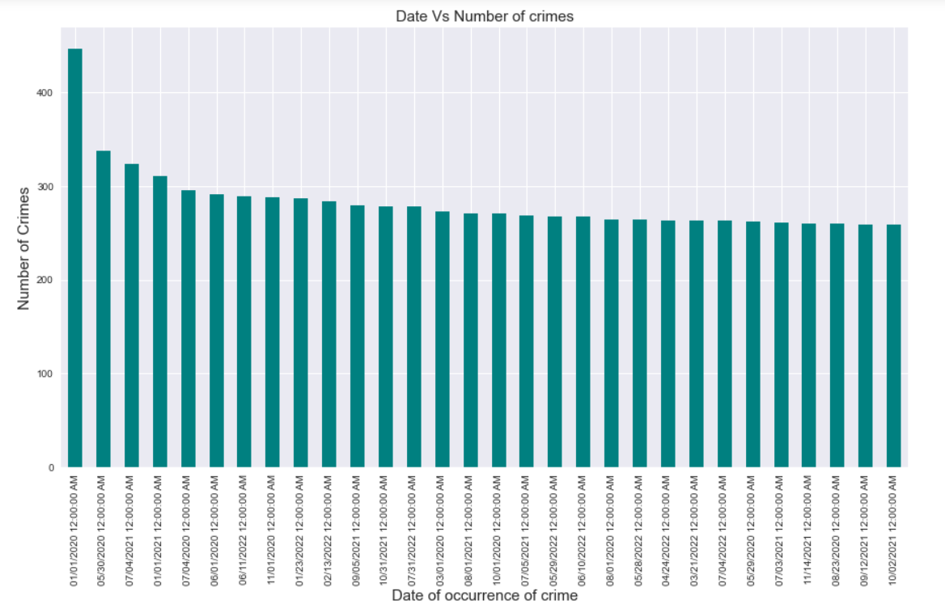
Top Crimes that occurred according to date

Slide 14
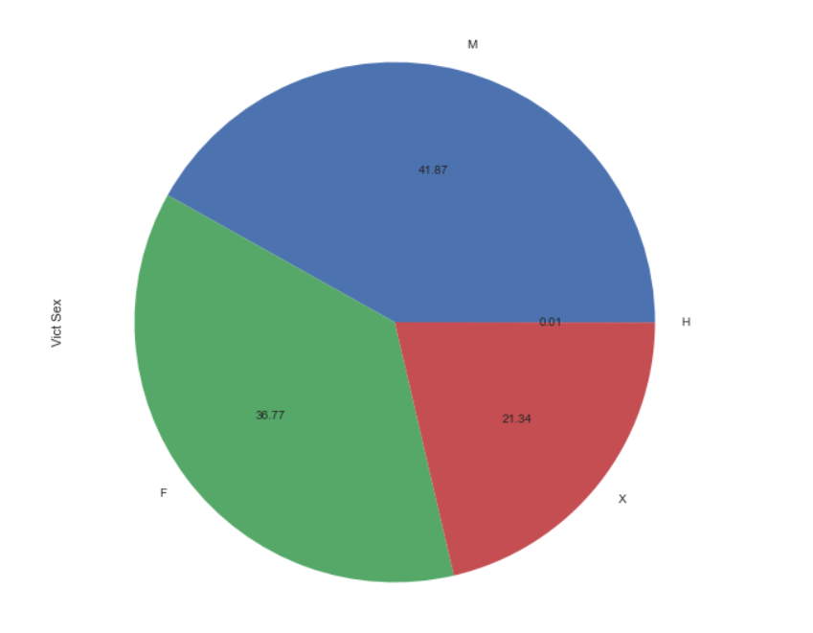
VICTIM SEX

Slide 15

Target Column

Slide 16
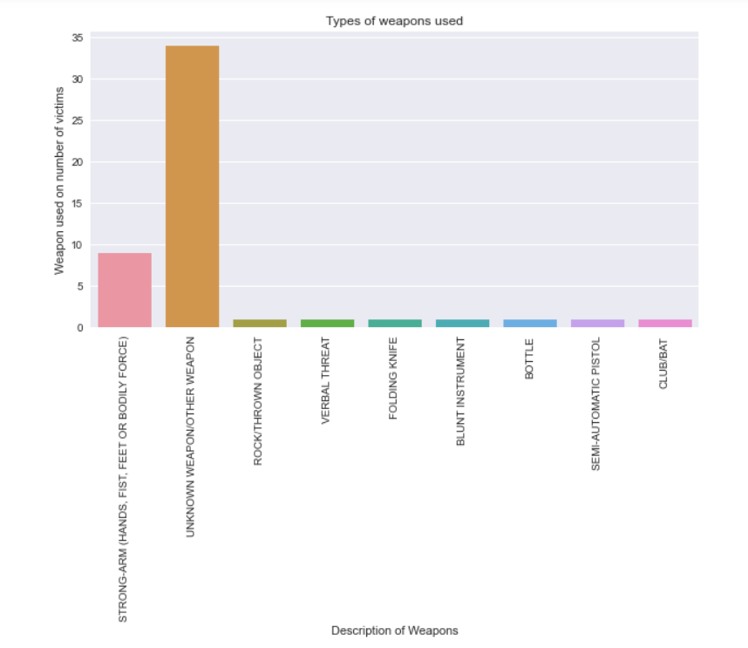
Different types of Weapons Used

Slide 17
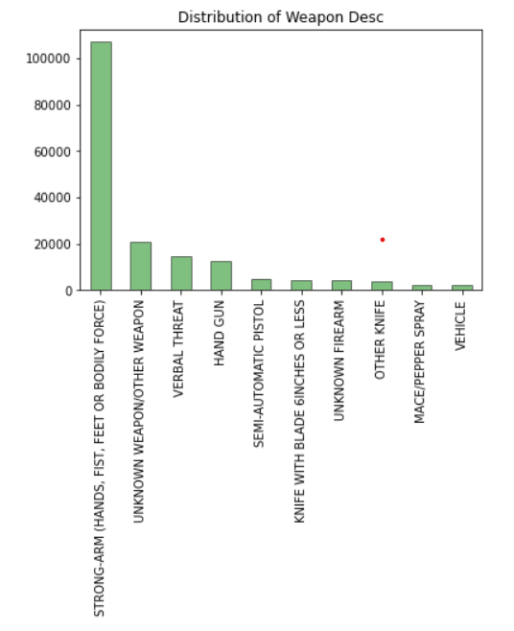
TARGET COLUMN

Slide 18
Machine Learning MODELS

Slide 19




Classification report
LOGISTIC REGRESSION
DECISION TREE
RANDOM FOREST
K-NEAREST NEIGHBORS

Slide 20
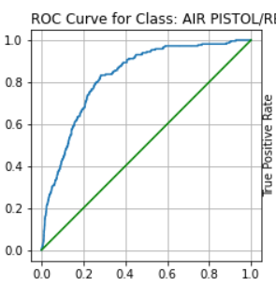
ROC CURVE

Slide 21

Conclusion

Slide 22
Male victims are more than female victims.
Battery- Simple Assault is the highest with nearly 50k crimes registered.
Streets are becoming the most dangerous place since the crime had occurred the most.
In 2021 the highest number of crime that occurred in a particular day are 330 crimes.
Bodily force such as Strong-Arms, hands, fist or feet are the weapons that are used in crimes.
Surprisingly Logistic Regression, Decision Tree and KNN Model has a same accuracy value. So all the three models are good for this data.
New Year 2020 the highest number of crimes occurred which are around 500 crimes.
7th Street in Los-Angeles is where the highest number of crimes i.e 18k crimes.
There are lot of crimes where the weapons are unknow which means the one who is committing the crime has used the object which are convenient to them at the premises. We cannot guess or predict the weapons after my complete analysis on the data what ever we predict is just 50% of what we have just to get the idea. We cannot expect or guess 100% of the weapon to be cautions about.

Slide 23
References
https://www.cpss.net/about/blog/2016/10/are-crime-statistics-always-accurate/
https://galelawgroup.com/robbery-faq/
https://www.slideshare.net/HetaParekh1/crime-data-analysis-and-prediction-for-city-of-los-angeles
https://data.lacity.org/Public-Safety/Crime-Data-from-2020-to-Present/2nrs-mtv8 https://medium.com/analytics-vidhya/los-angeles-crime-data-analysis-using-pandas-a68780d80a83 https://bja.ojp.gov/sites/g/files/xyckuh186/files/media/document/OverviewofCrimeAnalysis.pdf

